Slide 1
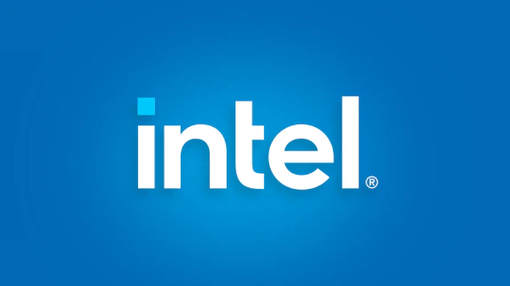

Slide 2
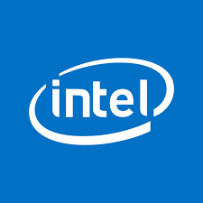

Recommendation
We provide a SELL recommendation for Intel
Current market price is $29.34
Our intrinsic valuation price is $18.12
Relative Valuation yielded $16.91, by taking the mean of P/E
Overall weighted valuation is placed at $17.76, by giving 70% weightage to DCF and 30% to relative valuation.

Slide 3
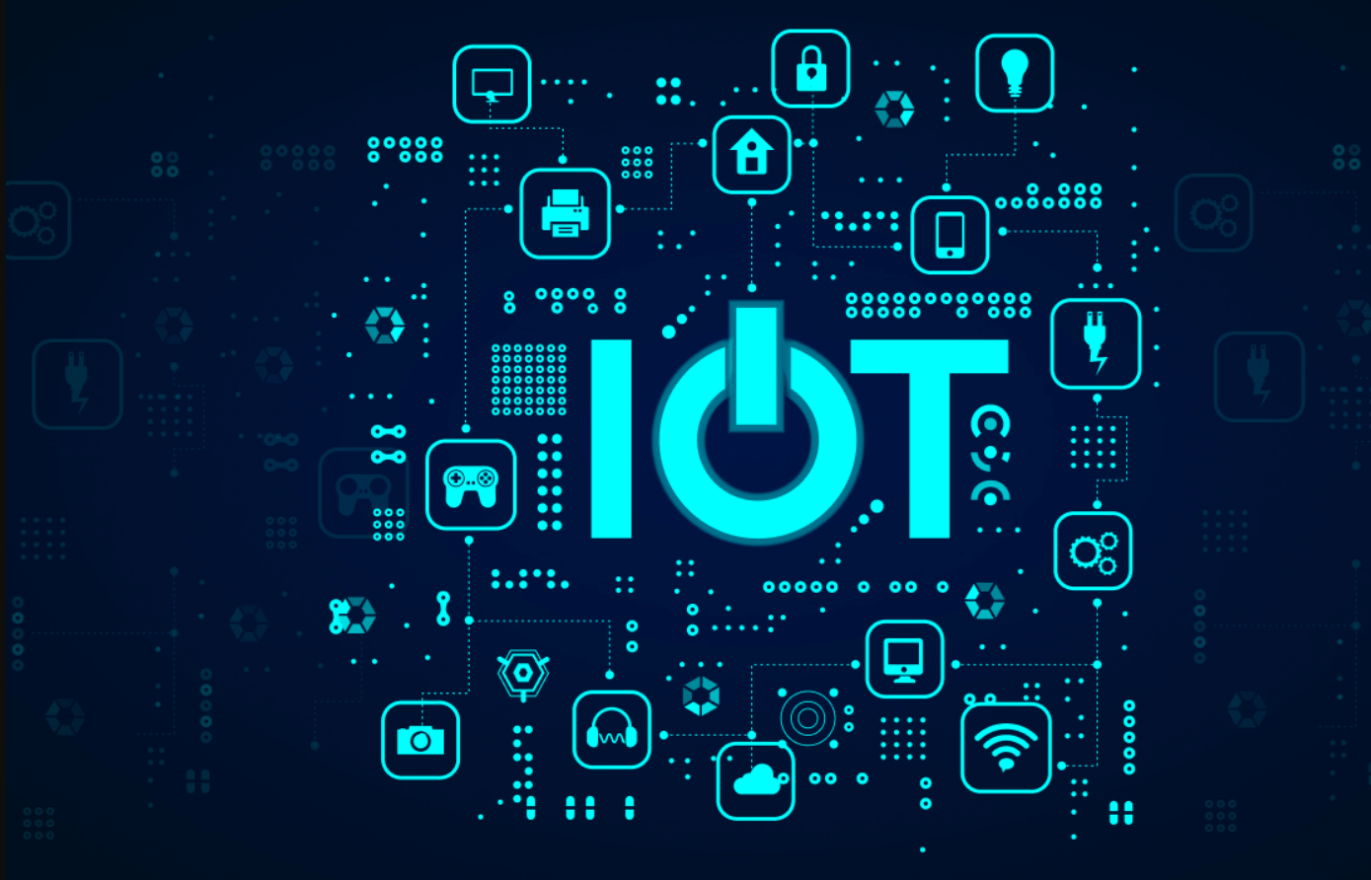
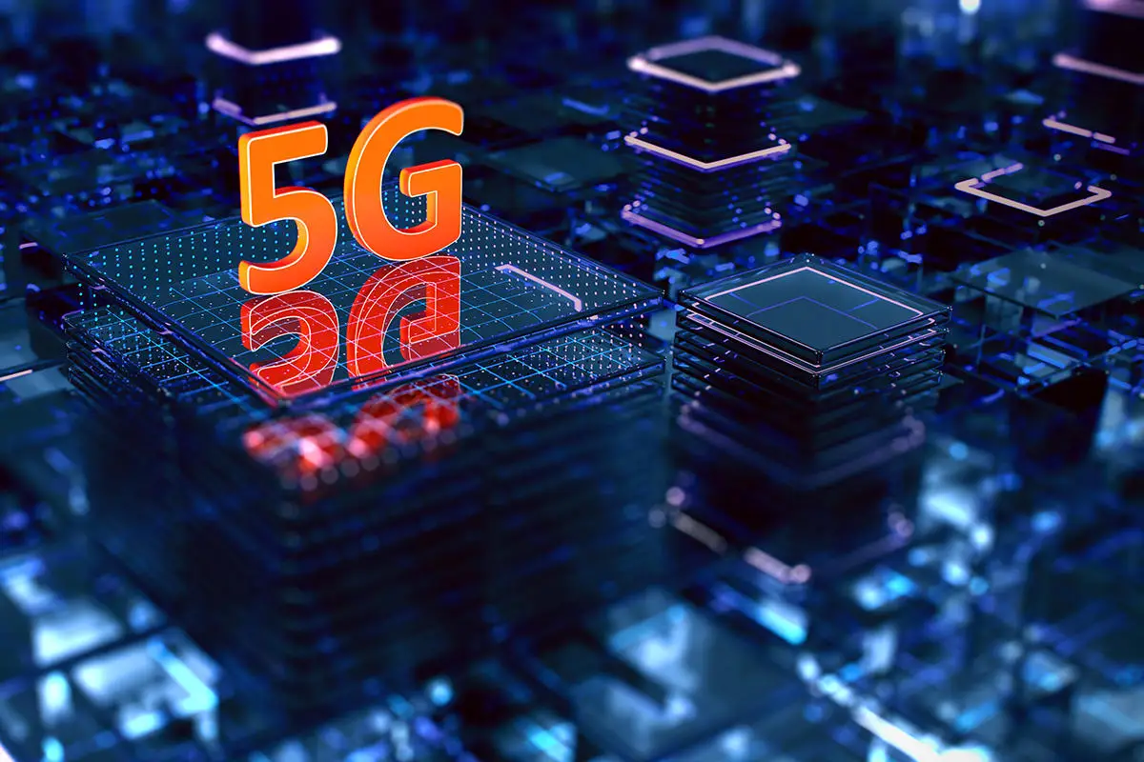
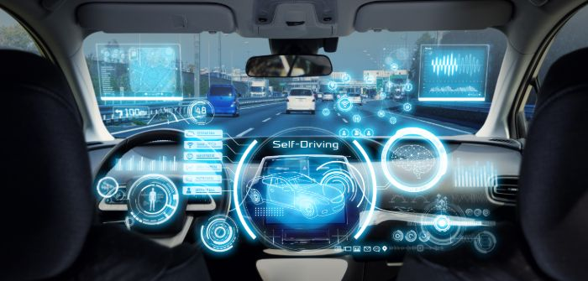
Business Description
Operations in 7 segments – Autonomous driving, 5g Networks, Client connectivity, Cloud computing, IOT, Client computing, and AI and Analytics.
73.7% market share of Laptops and CPUs
Revenue decreased by -20% YoY in the 3rd quarter of 2022,
Plunge in demand in Client Computing Group

Slide 4

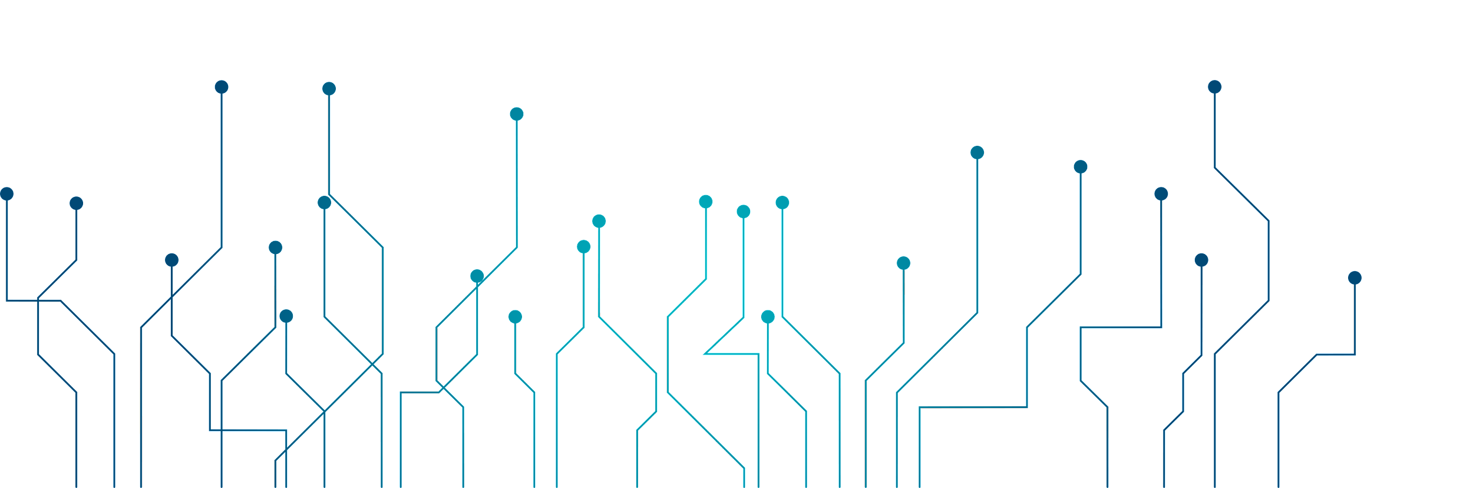
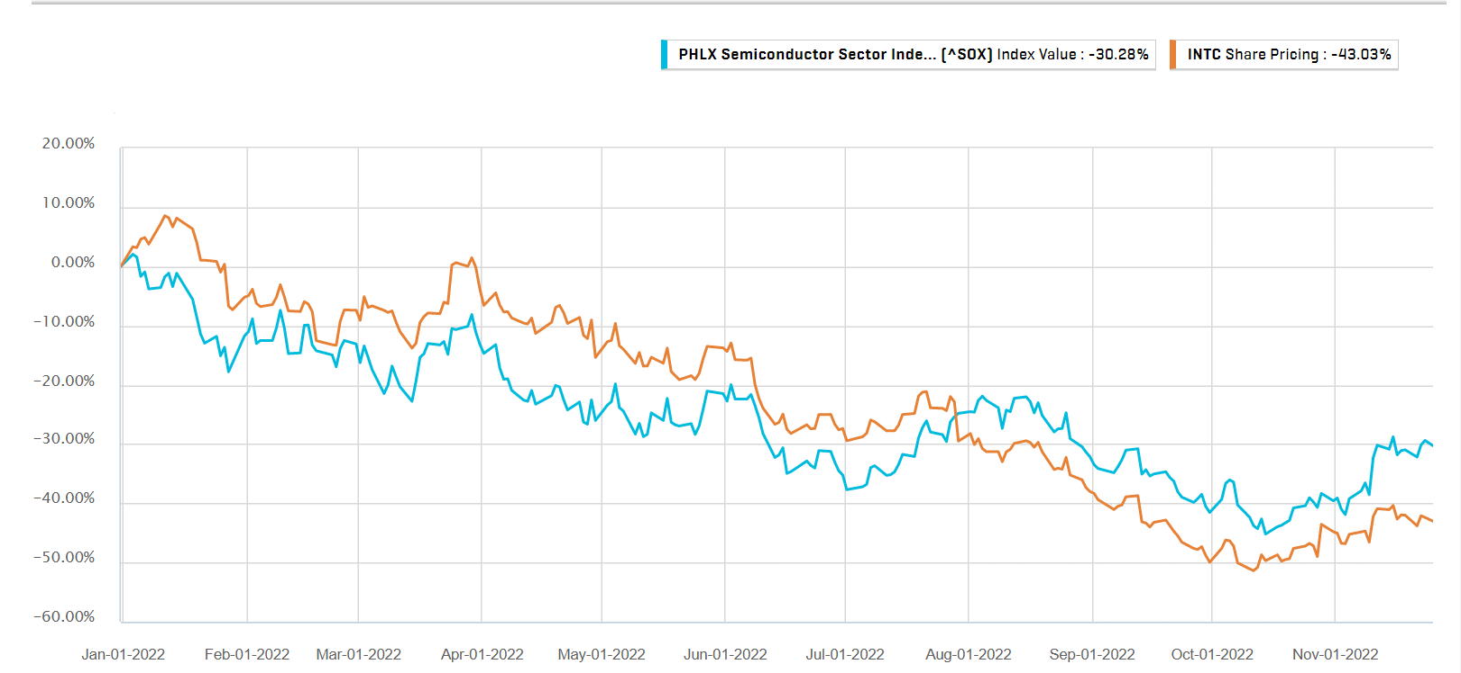
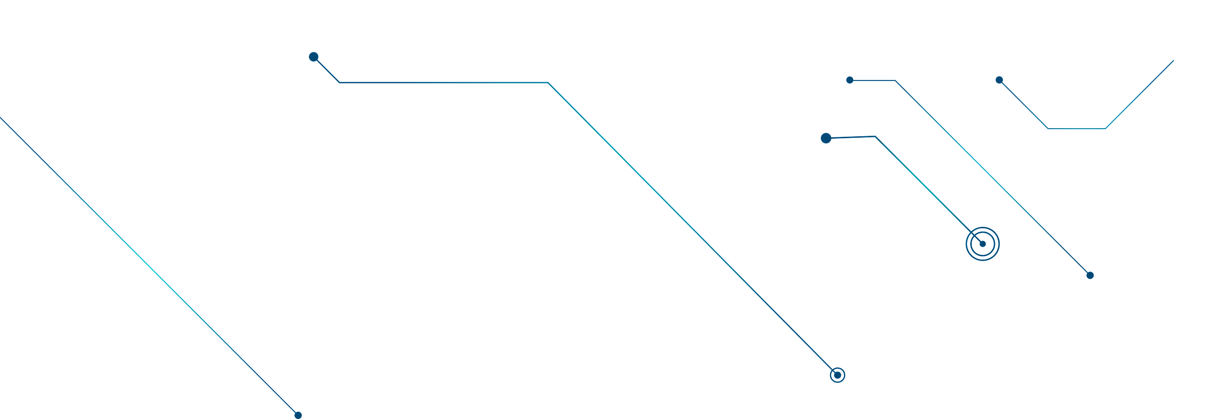
Industry Overview
🠺
Market Capitalisation of the semiconductor industry is $2.51 Trillion.
Around 12% of the world’s semiconductors are manufactured in USA.
Markets for PC and Tablets are currently declining and are further expected to decline by 2.3% in 2023.
The PHLX semiconductor index has declined by 30.28% YTD whereas Intel’s share price has declined 43.03% YTD.
Companies in the long term are bullish about the industry and the industry is expected to become a trillion dollar industry by 2029.

Slide 5
Past Financial Performance: Intel vs Peer Group
🠺
🠺

Slide 6
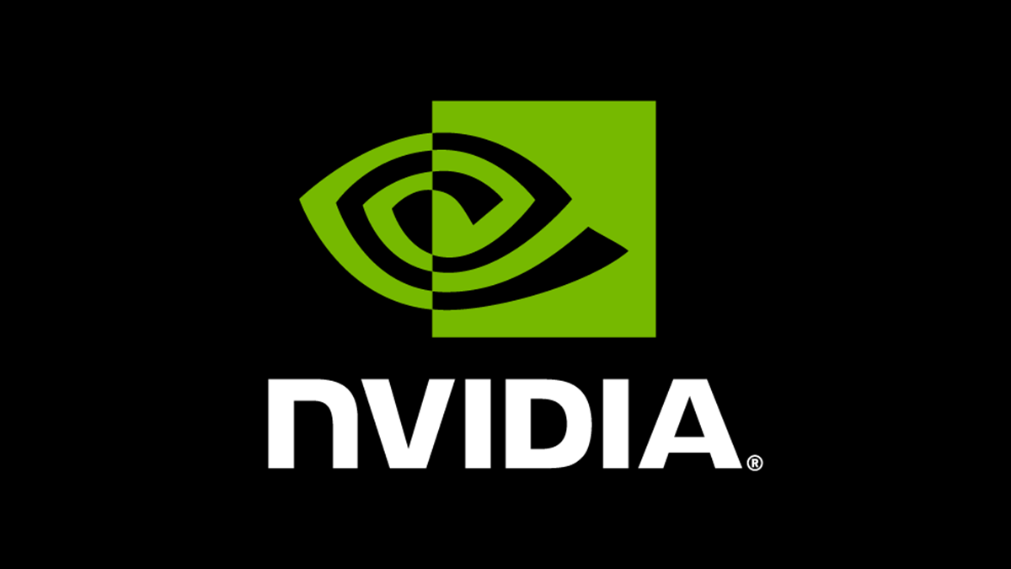


Our Peer Group

Slide 7
Competitive Positioning
T
1
🠺
Intel operates in a very competitive market. In the processor segment, the main competitor for Intel is Advanced Micro Devices (AMD) and other companies who operate on ARM architecture like Qualcomm Inc.
Intel’s main competitor is AMD and is gradually acquiring Intel’s market share over last few years.
🠺

Slide 8
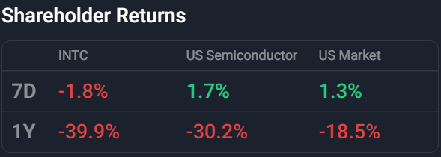
Intel Corporation reported decline in Revenue in the third quarter 2022 by -20.08%, from the same quarter in 2021. The contraction in the third quarter 2022 Intel Corporation's Revenue compares unfavorably to the Company's average Revenue growth of 5.83%.

Slide 9
00
Industry Key Drivers
T
1
🠺
🠺

Slide 10
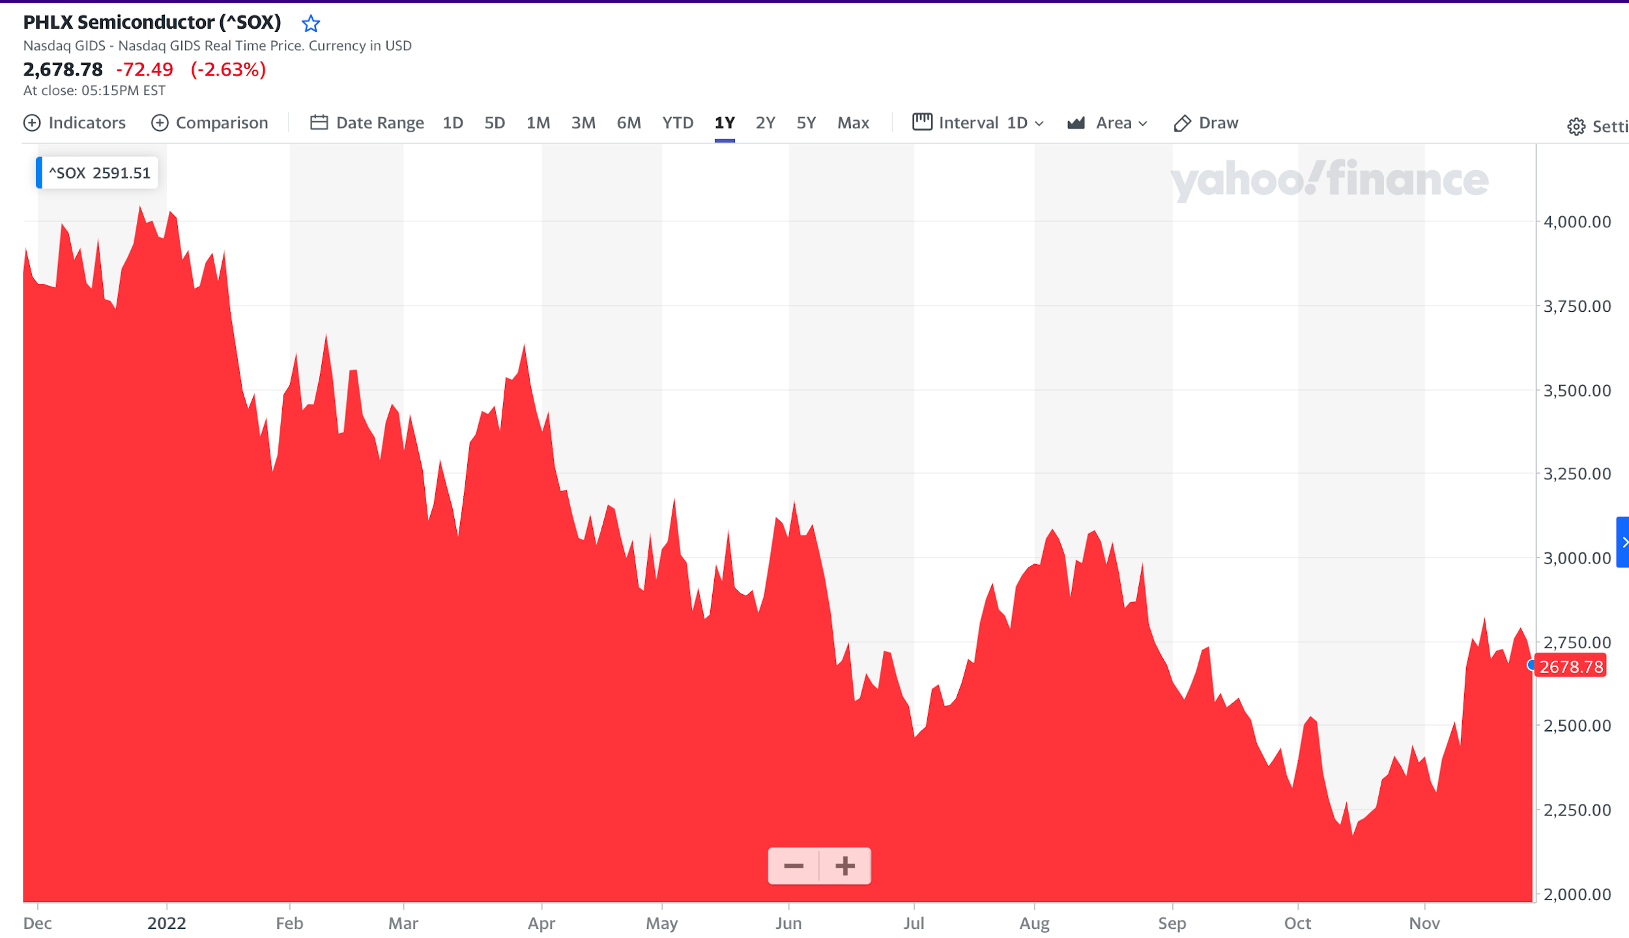
Chip demand is plunging rapidly in the short run as the PC demand hits 20-year low.
The need for chips is expected to increase during the next ten years.
The automotive, data storage, and communications industries are expected to grow by 70%. Intel includes planned growth in the client, data center, network, and edge markets.
The market for autonomous driving is expected to grow around 13.38% per year from 2022 to 2030. Opportunity for growth and inherent flexibility to Intel’s Mobileye.

Slide 11
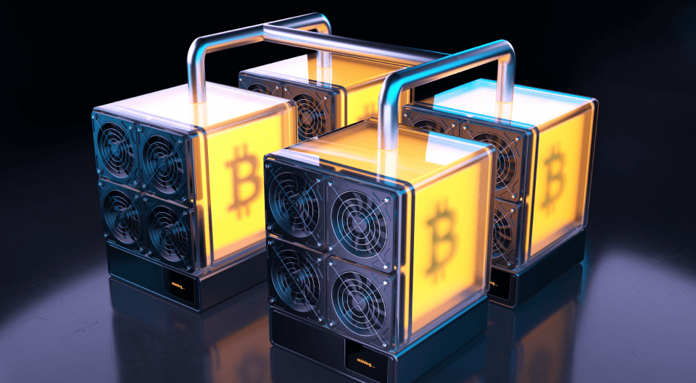

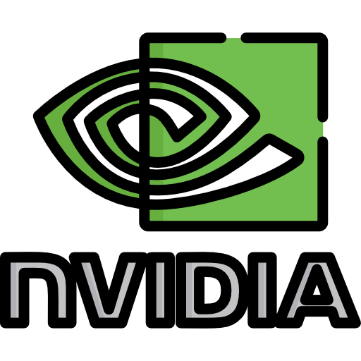
ASIC’s
6-8% average annual growth of the industry up to 2030, would take the industry to $1 trillion in revenue.
The annual growth is based on trends that include remote working, the growth of AI, and soaring demand for electric vehicles.
In the next five years, Application Specific Chips, which include ASSPs and ASICs, would contribute to the largest growth rate in revenue for both Wireless Communication and Computing categories.
Larger IDMs and fabless businesses like Intel (INTC), Texas Instrument (TXN), Nvidia (NVDA), and Advanced Micro Devices (AMD) may experience a cyclical boom because of chip scarcity.

Slide 12
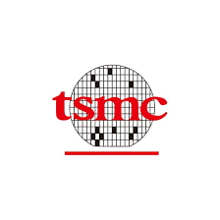
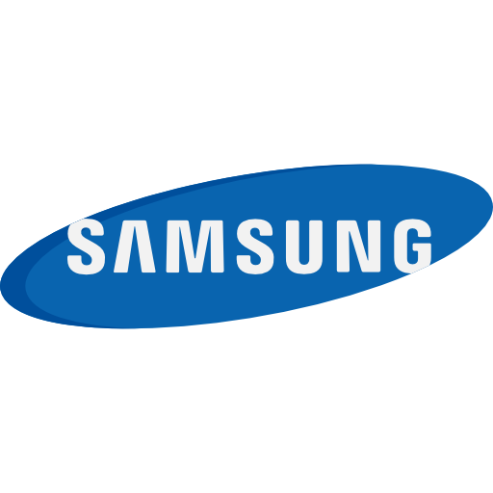

Foundries like TSMC and Samsung are projected to benefit the most until 2025.
With a market share of over 50% in the foundry sector, TSMC is expected to have revenue growth of 10% to 15% between 2020 and 25.
Intel's July 26 event laid out its processing technology and packaging roadmap including name changes, planning to overtake TSMC by 2024/2025.
Intel's potential $30 billion deal to buy GlobalFoundries is doable and would diversify its manufacturing footprint 50%, lifting sales 7%.
INTEL
TSMC

Slide 13
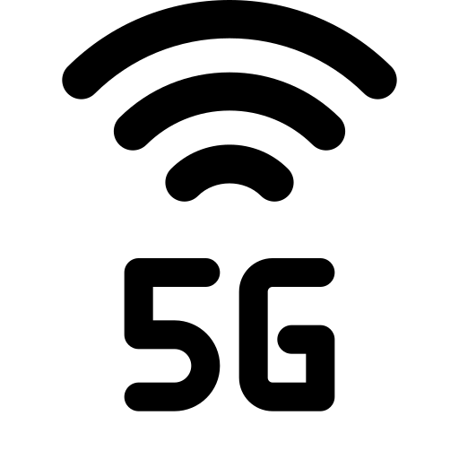

Long term demand of
semiconductor business
Increasing
5G wireless
Artificial Intelligence
Internet of Things
Cloud Computing
Machine Learning
With significant opportunities in cloud, networking, and AI, data center market expects TAM2 to grow approximately $119 billion by 2025.

Slide 14
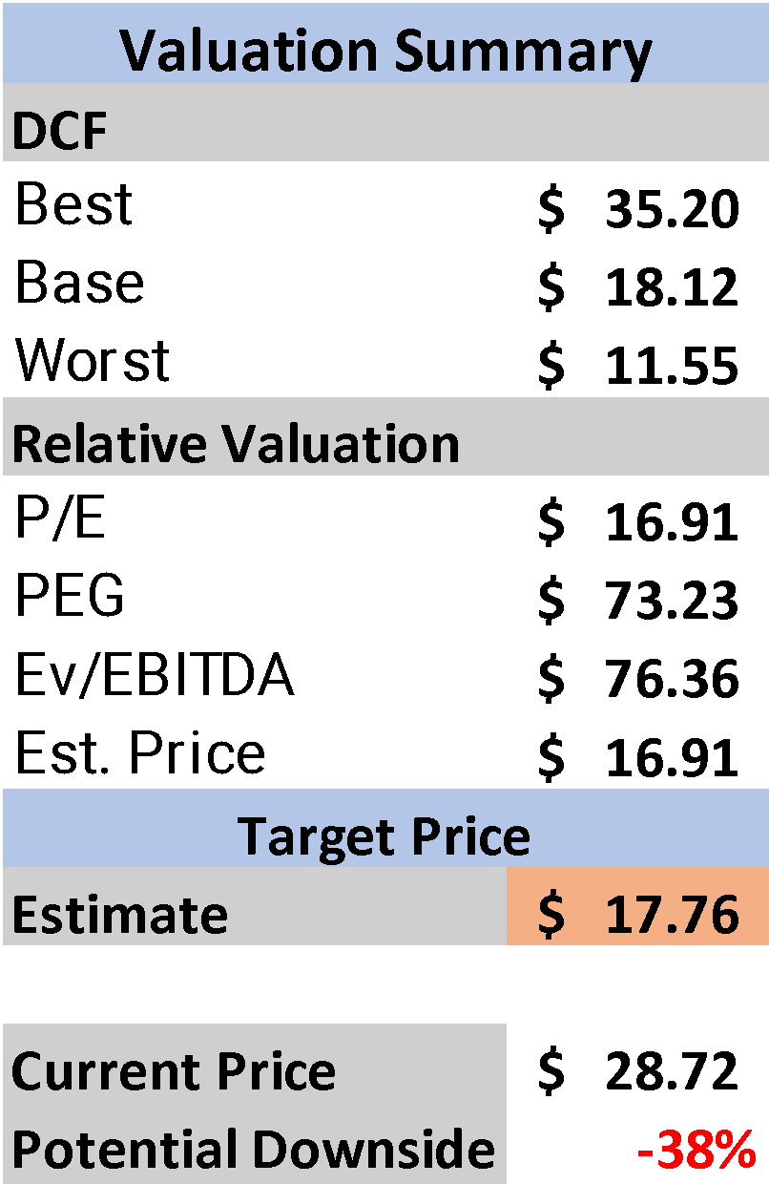
Intel Valuation
T
1
🠺
🠺
DCF
Low Base price as a result of reduced free cash flows for the company.
Company has weak fundamentals
70%
Relative Valuation
Intel is overvalued according to market sentiment.
Competitors are performing better.
30%
DCF & Relative Valuation both point out towards a sell rating
with a potential downside of 38%.

Slide 15
Investment Thesis
Complacency -> lack of innovation
Plans for new chips
3nm in 2024/25, 2nm by ‘27
Manufacture for Taiwan’s MediaTek
Underperformed PHLX Semi Index - 30.28% YTD vs Intel’s 43.03%
PC demand slump, but EV sector gaining ground
Intel concentrates on client computing
PC demand saw a huge spike in 2020
Intel’s YoY revenue has dropped 20% from last year
$10 billion in cost-cutting measures -> FCF
NOPAT decreasing
Potential for growth in 2027 if 2nm chips are released, but plans remain ambiguous
Intel will underperform peers
Even if investments in new chips pay off, it will be slower compared to peers

Slide 16
Business Risks
Interest Rate Risk
Convert fixed rate coupon payments into floating rate coupon payments for the company’s indebtedness.
Currency Exchange Rate Risks
Depreciated dollar can increase the cost of expenses as well as overseas capital expenditures.
Political Risks
There’s a possibility that China might attack Taiwan
Risk to Investment Thesis
Production of 2nm and 3 nm chips before 2027

Slide 17
ENVIRONMENT
Responsible Minerals Initiative (RMI)
Conflict minerals: 3TG (Tin, Tantalum, Tungsten, and Gold) and Cobalt
Audit smelters and locations
Energy conservation
“Green” buildings
Save 4 billion kWh by 2030 ($30 million)
SOCIAL
0.9% drop in % of women in workforce from 2020 to ‘21
40% female by 2030 (esp. In hardware and technical roles)
GOVERNANCE
Anti-corruption, transparency and accountability
Ethisphere Institute’s list of most ethical company for 12th year in a row
Named “trendsetter” in the 2021 CPA-Zicklin Index of Corporate Political Disclosure and Accountability

